Slide 2
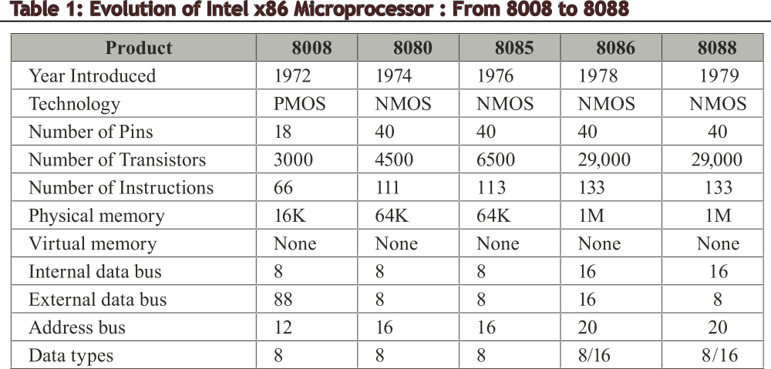

Slide 3
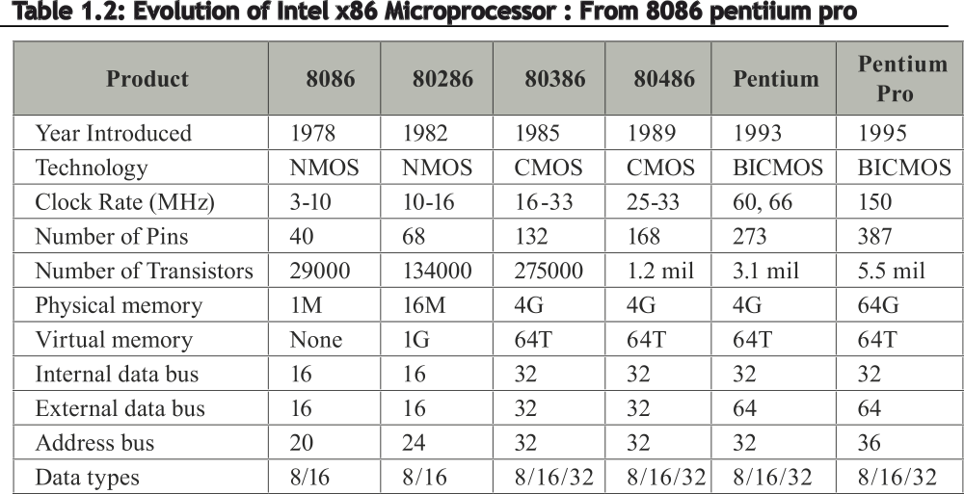

Slide 4
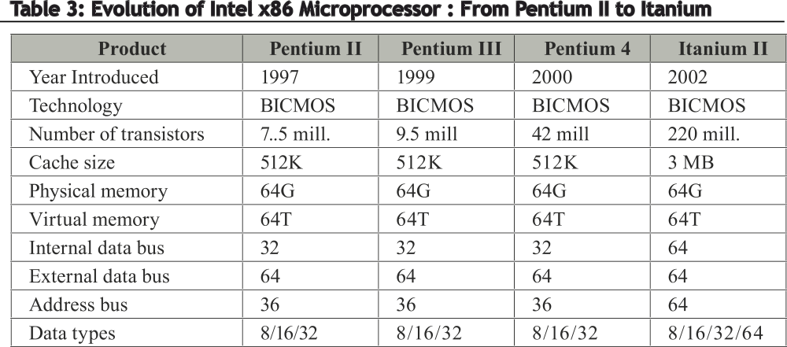

Slide 5
Features of 8086
It is a 16-bit processor. The width of ALU and data bus is 16-bits.
It has 20-bit address. Therefore maximum addressable memory is 2^20 = 1MegaBytes.
It has 40 pins and is a DIP package.
The address and data lines are multiplexed to reduce the number of pins.
It works on a frequency of 5MHz/10/8Mhz. It depends on external IC 8284 for frequency generation. 1 Sub division of time is 0.2 micro seconds
It is the first processor to support pipelining. The architecture is divided into Execution unit (EU) and Bus interface unit (BIU) for this purpose. BIU generates memory address and reads/writes from memory/IO. EU executes instruction fetched by BIU.

Slide 6
Logical memory partitioning
The memory of 1MB is partitioned as 16, segments of 64KB each.
One 64KB is used for storing program and is called “code seg”.
One 64KB is used for stack and is called “stack seg”.
One 64KB is used for storing data and is called “data seg”.
One 64KB is used for additional data and is called “extra seg”.
Memory address is represented as Base address:offset address from programmers view.
Base address provides the starting address of a segment and the offset address provides the offset within the segment.
Once base is initialized only the offset is to be provided in the instruction that makes the size of instruction small.

Slide 7
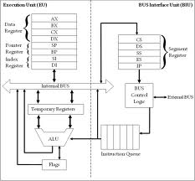
Architecture of 8086

Slide 8
Flag Register
CF: It is set if there is a carry from the MSB position addition else its reset
ZF: It is set if the result of operation in ALU is zero else it is reset.
PF: It is set if the no. of 1’s in a 8bit result is even else its reset.
AF: It is set if there is a carry from lower digit to upper digit in a 8-bit operation.
SF: It is set if MSB is ‘1’ indicating negative result; it is reset if the MSB is ‘0’ indicating positive result.
TF: When set causes processor to operate in trace mode. When reset causes the processor to execute in normal mode.
IF: When set the maskable interrupts are enabled; when reset the maskable interrupts are disabled.
DF: When set the strings are accessed in decremental order i.e last character to first; when reset the strings are accessed in incremental order i.e. first character to last.

Slide 9
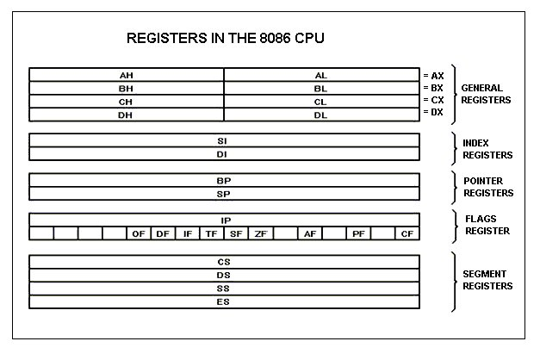
Registers

Slide 10
Registers
8086 CPU has 8 general purpose registers, each register has its own name:
AX - the accumulator register (divided into AH / AL): used as accumulator (AX-16-bit / AL – 8-bit accumulator)
BX - the base address register (divided into BH / BL): used as pointer to data segment and holds offset address for data seg.
CX - the count register (divided into CH / CL):Iterative code segments using the LOOP instruction
DX - the data register (divided into DH / DL):used as data register for MUL and DIV instruction and for Specifying ports in some IN and OUT operations
SI - source index register:Can be used for pointer addressing of data. Used as source in some string processing instructions

Slide 11
Registers
DI - destination index register: Can be used for pointer addressing of data segment and extra segment. Also Used as destination in some string processing instructions
BP - base pointer: Primarily used to access parameters passed via the stack. Offset address relative to SS
SP - stack pointer:Always points to top item on the stack. It holds the offset address relative to SS.
Segment registers – 8086 has 4 segment register namely CS-reg, DS-reg, SS-reg, ES-reg which holds the base address for the respective segments.
IP – Instruction pointer which holds the offset address for code segment.

Slide 12
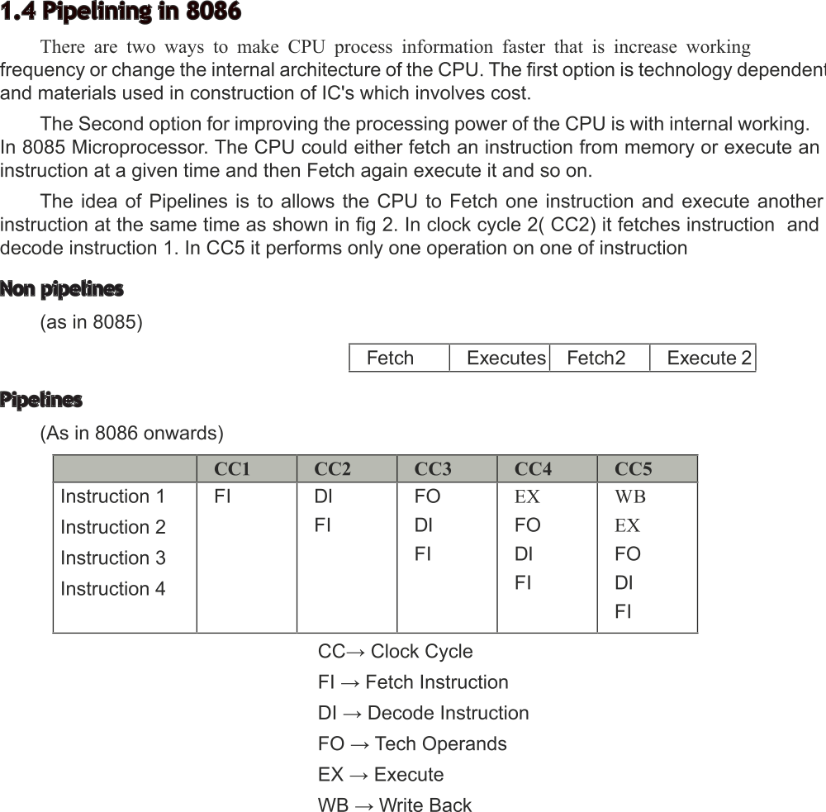

Slide 13
ADDRESSING MODES
Every instruction has 2 parts: a OPCODE and a OPERAND.
OPCODE indicates the job to be done.
OPERAND is the data on which the job is done.
Addressing modes are the different ways of specifying the data and its location in the instruction. The addressing modes can be viewed as Data related addressing modes, program counter related addressing modes and stack addressing modes.
DATA RELATED AM:
The various data related addressing modes are :
1. Register AM 2. Immediate AM 3. Direct AM 4. Register indirect AM 5. Base plus indexed AM 6.Register Relative AM 7. Base plus relative plus indexed AM 8. Scaled index AM (only in 80386 and above)

Slide 14
ADDRESSING MODES
1.Register AM: In this AM the data required for the operation is stored in a register specified in the instruction.
Syntax: Reg Data = (Reg) [read as content of register ]
2.Immediate AM: In this AM the data required for the operation is specified as a part of the instruction itself.
Syntax: n Data = n, itself
3.Direct AM: It is a memory addressing mode. The offset address of the memory data is given as a part of the instruction.
Syntax: [n] offset address : n address : DS:n
4.Register indirect AM: It is also a memory addressing mode. The offset address of the memory data is stored in the register specified in the instruction.
Syntax: [reg] Offset address = (Reg) Data = DS: (reg)

Slide 15
ADDRESSING MODES
5.Register Relative AM: In this AM a displacement is mentioned in the instruction along with the register. The offset address of the data is the sum of the displacement and the content of the register.
Syntax: n[Reg] or [reg+n] offset address = n+(reg) Data = DS:(n+(Reg))
6.Base + Indexed AM: In this AM the offset address is the sum of the content of base register(BP, BX) and content of index register(SI,DI)
Syntax: [REGb][REGi] Offset address = (REGb)+(REGi)
7.Base + indexed + relative AM: It is a memory addressing mode. The offset address of the memory data is the sum of base register, index register and relative displacement.
Syntax: n [REGb][REGi] Offset address = (REGb)+(REGi)+n
8.Scaled Index AM: It is also a memory addressing mode.
Syntax: [reg1+n*reg2] Offset address = (Reg1)+n*(reg2)

Slide 16
Program memory AM
It is used with JMP and CALL instructions. There are 3 AM namely: direct, relative and indirect.
It is used during branching operation. To realize branching the value of CS and IP has to be changed. There are 2 types of realization:
1. Intra segment or NEAR branch and 2. Inter segment or FAR branch.
In case of intra segment branch the branching is between same segment and hence only IP has to be changed. In case of inter segment branch the branching is between 2 different segments and hence both IP and CS have to be changed.
Direct Program addressing:
In this case the address is stored in the instruction itself.
For eg. JMP [1000h]

Slide 17
Program memory AM
Direct AM in inter segment braching: In case of inter segment branching the instruction is of 5 bytes as shown below:
Eg. JMP [10000h] will be coded as : Base = 1000h and IP = 0000
Relative program memory addressing: Here the branching is relative to the IP. No inter segment is possible with relative AM. The instruction will have a 8-bit (short) or 16-bit (near) displacement in the instruction. The new value of the IP is obtained by adding the IP with the displacement
i.e. (IP) = (IP) + displacement.
Opcode | Offset low | Offset high | Segment low | Segment high
Opcode | 00 | 00 | 00 | 10

Slide 18
Program memory AM
Indirect Program AM: In case of intra segment indirect the register or memory specified in the instruction gives the offset value for the branching. i.e. JMP reg/mem
on execution (IP) = (reg/mem).
In case of inter segment indirect a memory is specified which is a 32-bit memory. The 1st 16-bit number is taken to IP as the offset and the next 16-bit number to CS as the segment address.
i.e. JMP dword ptr mem
(IP) = ( mem)
(CS) = ( mem + 2)
Mem+0
Mem+1
Mem + 2
Mem + 3
Offset low
Offset high
Seg low
Seg high

Slide 19
Stack memory AM
Stack holds data temporarily and stores return addresses for procedures. Stack works on LIFO basis.
PUSH instruction is used to place data on the stack and POP instruction is used to remove the data from stack.
The stack is maintained by SS and SP where SS is the segment register for the stack and SP is the offset address for the stack.
While pushing data on the stack the SP is decremented and while poping the SP will be incremented.
The push sequence is :
a. The lower 8-bit of data is pushed at an location SS:(SP)-1
b. The upper 8-bit of data is pushed at a location SS : (SP) – 2
c. SP is readjusted as SP-2

Slide 20
Stack memory AM
The sequence of the poping is :
a. The content of the stack top pointed by SS : (SP) is brought the lower 8-bit of the destination.
b. The content of the stack top pointed by SS : (SP) + 1 is brought the upper 8-bit of the destination.
c. The SP is readjusted as SP+2
Data in stack are pushed or poped as 16-bit value only
What is wrong with MOV [BX] , [D] ? Both the operands are memory operands which is not possible.
Select instruction for:
a. move 12h to AL ------------ MOV AL,12H
b. copy DS into AX ----------- MOV AX , DS

Slide 21
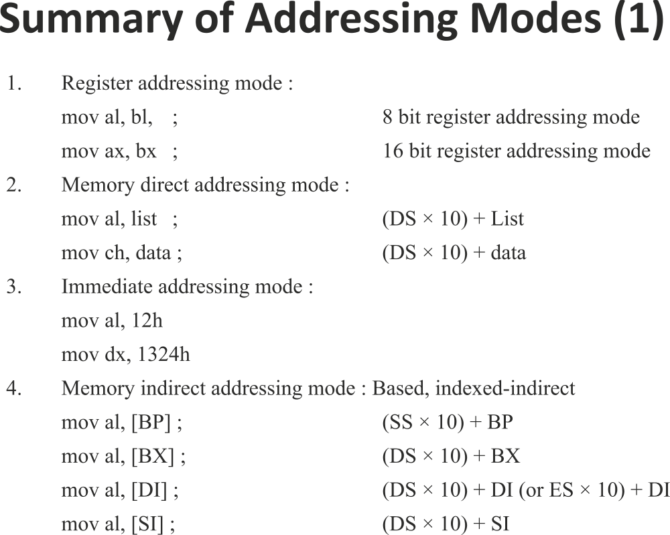

Slide 22
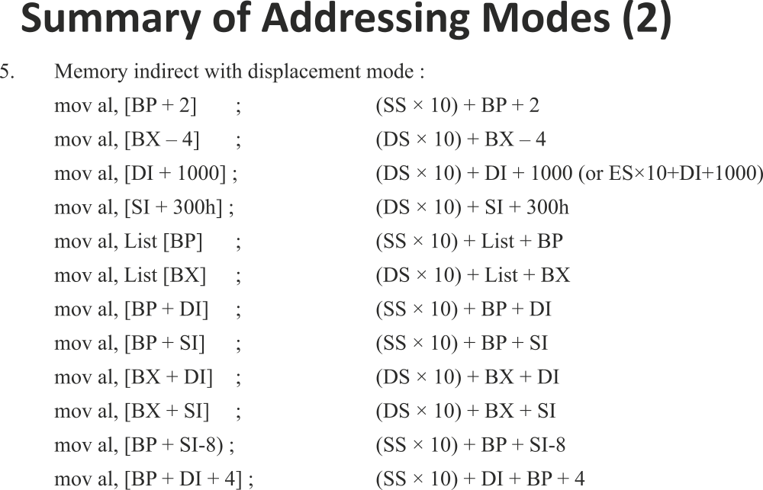

Slide 23
Directives
Assembler Directives: These are pseudo codes and helps the assembler in the processes of conversion. These are transparent to the processor.
The commonly used assembler directives are :
1. DB: used to define a variable of byte size. It is equivalent of “char” declaration in C-language. The usage format is <var> db <initl value>
eg. X db 23; x db 1,2,3,4 ; x db “kumar”
2. DW: used to define a variable of word size. It is equivalent of “int” declaration in C-language. The usage format is <var> dw <initl value>
3.DD: used to define a variable of double word size. It is equivalent of “long int” declaration in C-language. The usage format is <var> dd <initl value>
4.DQ:used to define a variable of quad word size. The usage format is <var> dq <initl value>
5.DT:used to define a variable of Ten byte size. The usage format is <var> dt <initl value>

Slide 24
Assembler directives
6.DUP operator: It is used to reserve memory and initialize with common value. Eg. X db 20 dup(0)
7.proc and endp: These two directives are used to define a procedure or subroutine. The usage format is :
<name> proc
|
| Body of the procedure.
|
<name> endp
8.EQU: It is used to define a symbolic constant. It does not require any memory declaration. At the time of assembling the symbol is replaced by the value. The usage format is : <Symbol> equ <constant>
9.ORG: It is used to change the offset address of the declaration below.
org 3000

Slide 25
Assembler directives
Segment and ends: Used to define a segment. The format of usage is <name> segment
|
|
|
<name> ends
Assume: used to assign a name of segment with its segment register
assume <segreg>:<name>
There are 2 instruction formats: 16-bit form and 32-bit form.
16-bit form is used in 8086 systems and the 32-bit format is specific to 80386 and above processors.

Slide 26
Types of instructions
Data transfer instructions: mov,push,xchg,pop,push,xlat,lea,les,lds,lahf,
Sahf,pushf,popf,in,out.
Arith metic instructions:add,adc,inc,sub,sbb,dec,aaa,add,daa,das,aam.
Program exe. Transfer inst:call,jmp,ret(u/c),jz,jnz,jc,jnc(cond) etc.
Processor control inst:stc,std,clc,cld,sti,cli etc.
String instructions:movs/b,cmpsb/w,stosb/w,lodsb/w,stosb/w.
Bit manipulationinst:and,or,xor,sal,ahl,sar,ahr,rol,ror,rcl,rcr.

Slide 27
REG: The 3-bit field defines the register used as the first operand in the
REG | 000 | 001 | 010 | 011 | 100 | 101 | 110 | 111
W=0 | AL | CL | DL | BL | AH | CH | DH | BH
W=1 | AX | CX | DX | BX | SP | BP | SI | DI
R/M | Mod = 00 | Mod = 01 | Mod = 10 | Mod = 11
000 | (BX) + (SI) | (BX) + (SI)+D8 | (BX) + (SI) | Same as REG field defined above
001 | (BX) + (DI) | (BX) + (DI)+D8 | (BX) + (DI)
010 | (BP) + (SI) | (BP) + (SI)+D8 | (BP) + (SI)
011 | (BP) + (DI) | (BP) + (DI)+D8 | (BP) + (DI)
100 | (SI) | (SI)+D8 | (SI) +D16
101 | (DI) | (DI)+D8 | (DI)+D16
110 | DIRECT AM | (BP) + D8 | (BP) + D16
111 | (BX) | (BX) + D8 | (BX) + D16

Slide 28
Data Coding
Obtain machine code for instruction : MOV DL , [DI]
Byte 1: 6 bits opcode – 100010
W-bit = 0 as it is a 8-bit operation
D-bit = 1 as the register operand is destination
Therefore Byte 1 is 100010 1 0 = 8A
Byte 2: MOD = 00 as the 2nd operand is memory without displacement.
REG = 001 corresponding to DL register.
R/M = 101 corresponding to OA=(DI)
Therefore byte 2 is 00 010 101 = 15
Therefore the opcode of the instruction is
8A 15

Slide 29
Data transfer using MOV
The format for immediate addressing with MOV instruction is:
Eg. MOV AX,1234h
MOV instructions:
1. MOV segreg, reg 2. MOV reg , segreg
(segreg) (reg) (reg) (segreg)
3. MOV reg1/mem1 , reg2/mem2 4. MOV reg/mem, immdata
(reg1/mem1) (reg2/mem2) (reg/mem) data
Note: when memory is used in instruction 4 the size of the memory has to be specified by using assembler directives byte ptr / word ptr / dword ptr

Slide 30
Data tfr instructions
PUSH instruction: Possible push instructions are :
1. PUSH reg 2. PUSH mem 3.PUSHF 4. PUSHA 5. PUSH sreg
Note: With PUSHF the flag register is pushed on the stack and with PUSHA instruction AX, CX, DX, BX, SP, BP, SI and DI in the same order will be pushed.
The sequence of operation on push instruction are :
(SS: ( SP)-1) (Src upper byte)
(SS: (SP)-2) (Src lower byte)
(SP) (SP) - 2
POP instruction : Possible pop instructions are :
1. POP reg 2. POP mem 3. POPF 4. POPA 5. POP sreg
The sequence is : (dst lower byte) (SS : (SP) )
(dst upper byte) (SS : (SP) + 1)
( SP ) ( SP ) + 2

Slide 31
DATA transfer instructions
What is the effect of following sequence: PUSH AX
        PUSH BX
        POP AX
        POP BX
Initialization of the stack:
sseg segment .model small
dw 100h dup (?) (OR) .stack 200h
sseg ends
LEA instruction: It loads the effective address of the memory specified into the register specified. LEA reg,mem
(reg) offset address of mem
It is used as a pointer initialization instruction.

Slide 32
example
Consider swapping of 2 data :
.model small
.data
data1 dw 2000h
data2 dw 3000h
.code
lea si,data1 ; si is the pointer to data1
lea di,data2 ; di is the pointer to data2
mov bx,[si] ; move data1 into bx
mov cx,[di] ; move data2 into cx
mov [si],cx ; move data2 to memory pointed by si
mov [di],bx ; move data1 to memory pointed by di
.exit
end

Slide 33
Data tfr instructions contd….
LDS and LES instruction: These load any 16-bit register with an offset address and the DS, ES segment register with a segment address.
i.e. LDS reg, mem
(reg) = (mem)
( DS ) = (mem+2)
Exchange instructions:
a) XCHG ax, reg16 b) XCHG reg, reg/mem
(AX) (reg16) (reg) (reg/mem)
LAHF SAHF
(AH) = ( flags lower byte) ( flags lower byte) = (AH)
IN acc,portaddr8 IN acc,dx
(acc) (portaddr8) (acc) ((dx))
This is a fixed IO addressing (8-bit addr) This is a variable port addressing (16-bit addr)

Slide 34
Instructions contd….
XLAT: This is an instruction most suited for lookup table technique.
The offset address of memory is (BX) + (AL). On execution the data from DS:OA is brought to AL register
i.e. (AL) ( DS : (BX) + (AL))
When to be used for the lookup table the following steps are to be followed: 1. Prepare the table as per the requirement.
2. Make BX as pointer to the Table.
3. The number for which conversion is required is loaded in AL
4. Execute XLAT instruction and the result will be in AL.
Eg. BCD to ASCII conversion.
BCD 0-9 corresponds to 30h – 39h in ASCII. Lea bx,table address
Mov al,number;al=01h
Xlat ;al=31h
Step1: look up table:
30h
31h
¦
39h

Slide 35
Instruction contd…
Step 2: LEA BX,table Step 3: MOV AL,num Step 4: XLAT
Program:
.model small
.data
table db 30h,31h,32h,33h,34h,35h,36h,37h,38h,39h
num db 04
res db 00
.code
lea bx, table
mov al, num
xlat
mov res , al
.exit
end

Slide 36
String instructions
During the string operations the source string is always addressed by DS as segment base and SI as offset, the destination string is always addressed by ES as segment base and DI as offset.
If during string operation the Direction-Flag (DF) = 0 the pointers Si and DI are incremented after the operation. If DF = 1 the pointers SI and DI are decremented after the operation.
LODS instruction: It loads a string/character from source to accumulator. LODSB causes a byte to be loaded to AL-register and LODSW causes a word to be loaded to AX-register.
i.e. LODSB -----→ (al) (DS:SI)
after if DF=0 SI=SI+1; DF=1 SI=SI-1
LODSW >>>>> (ax) (DS:SI)
after if DF=0 SI=SI+2; DF=1 SI=SI-2
LODSD is possible in 80386 and above processor

Slide 37
String instruction
STOS instruction: It stores the accumulator content to the destination.
STOSB causes a byte to be loaded from AL-register to memory pointed by ES:DI and STOSW causes a word to be loaded from AX-register to memory pointed by ES:DI.
i.e. STOSB -----→ (al) (ES:DI)
after if DF=0 DI=DI+1; DF=1 DI=DI-1
STOSB >>>>> (ax) (ES:DI)
after if DF=0 DI=DI+2; DF=1 DI=DI-2
STOSD is possible in 80386 and above processor.
REP prefix can be used with STOS instruction which causes the instruction to be repeated until the count in CX ! = 0 i.e. The value of CX will be decremented by 1 and if not equal to zero the instruction STOS is repeated.

Slide 38
String instructions
A video text memory begins from B800:0000, There are 25 X 80 character per line and each character has 2 bytes. The first byte is the ascii of character. The 2nd byte is the attribute. Write a program to clear the screen.
SOLN: The attribute is 07 (white text on a black background)
The ascii of space is 20h
.model tiny
.code
mov ax,0b800h
mov es,ax
mov di,00
mov cx,25*80
mov ax,0720h
REP stosw
.exit

Slide 39
String instructions
MOVS instruction: It moves a character from source string to destination string.
i.e MOVSB (ES:DI) (DS:SI)
After if DF=0 SI++ , DI++ ; DF=1 SI-- , DI—
MOVSW (ES:DI) (DS:SI)
After if DF=0 SI=SI+2, DI=DI+2
=1 SI=SI-2, DI=DI-2
REP prefix can be used with MOVS instruction.
PBLM: write program to move value of location B800:00A0 to B800:0000 , a total of 24*80 characters.
SOLN: The above program in continuation with the previous program can be used to scroll the page in the new location.

Slide 40
String instruction
.model tiny
.code
cld
mov ax, 0b800h
mov ds, ax
mov es, ax
mov si, 00A0h
mov di, 0000
mov cx, 24*80
REP movsw
.exit
end

Slide 41
Questions on DATA move instructions
Q1: Develop a near procedure that stores AL in four consecutive memory location within data segment addressed by DI-reg.
movemem proc near
mov cx,04
ag: mov [di],al
inc di
dec cx
jnz ag
ret
movemem endp

Slide 42
Questions on DATA move instructions
Q2: Develop a far procedure that copies contents of the word-sized memory location CS:DATA1 into AX,BX,CX,DX,SI
movemem proc far
mov ax,seg
mov cs,ax
lea di,data1
mov ax,[di]
mov bx,[di]
mov cx,[di]
mov dx,[di]
mov si,[di]
ret
movemem endp

Slide 43
Logical instructions
AND operation: It is used for performing logical AND operation on the two operands.
The possible formats and instructions are:
1. AND reg2 ,reg1 2. AND reg/mem, immdata
3. AND mem,reg 4. AND reg ,mem.
AND operation can be used for clearing a bit or masking a bit of a given register or memory. For eg. If A7 , A5 , A2 of CL-reg to be cleared:
A7 A6 A5 A4 A3 A2 A1 A0
& 0 1 0 1 1 0 1 1 = 5 b
Therefore instruction is :
AND CL , 5bh

Slide 44
Logical instructions
OR instruction: The possible instructions in OR gate operations are:
1. OR reg2 ,reg1 2. OR reg/mem, immdata
3. OR mem,reg 4. OR reg ,mem.
OR instruction can be used for setting a bit of a register or memory.
XOR instructions: The possible instructions in XOR gate operations are:
1. XOR reg2 ,reg1 2. XOR reg/mem, immdata
3. XOR mem,reg 4. XOR reg ,mem.
XOR instructions can be used for complimenting a bit of a register or memory.
NOT and NEG: NOT instruction is used to get 1’s compliment of the operand. Instruction is NOT reg/mem.
NEG instruction is used to get 2’s compliment of the operand.
Instruction is NEG reg/mem

Slide 45
Logical instructions
TEST and BIT test Instruction: TEST instruction performs AND operation between the 2 operands and then flags are affected based on the result, but the result is discarded. TEST instruction is followed by JZ ( Jump if Zero) or JNZ(Jump if not Zero) instruction.
eg. Test whether bit 0 of al-reg. If the bit = 1 branch to RIGHT
TEST AL,1
JNZ RIGHT
Write a program to clear D0,D1 ; set D2,D3; compliment D6,D7 of a 8-bit memory data.
i/p: D7 D6 D5 D4 D3 D2 D1 D0
O/P: D7 D6 D5 D4 1 1 0 0
Setting is achieved by OR operation; Clearing by AND operation ; Complimention by XOR operation.

Slide 46
Logical instructions
.model small
.data
num db 24h
res db 0
.code
mov ax,@data
mov ds,ax
mov al,num
and al,0FCh; To clear D0,D1
or al,0Ch ; To set D2,D3
xor al,C0h ; To compliment D6,D7
mov res,al
.exit
end

Slide 47
Shift and Rotate
Shift instructions move bits in a register or memory left/right. A Left shift performs a multiplication in power of 2^{n} and a right shift gives quotient of division by power of 2^{n} . The instructions of shift are:
Cy Register or memory
SHL/ 0
SAL
SHR 0 Cy
SAR Cy

Slide 48
Shift and rotate instruction
All rotate and shift instructions can be performed once or ‘n’ times. If to be performed once the syntax is : SHL AX,1
If the operation is to be performed ‘n’ times then the value of ‘n’ is to be loaded into CL-register. Eg. SHL AX,CL
Rotate instrutions:
ROL
RCL ROR
RCR

Slide 49
Logical instructions
Write a program segment to multiply ax by 10.
SHL AX,1 ; Multiplication by 2
MOV BX,AX ;
SHL AX,2 ; Multiplication by 8
ADD AX,BX
Write a program segment to multiply AX by 5.
MOV BX,AX ; (BX) = NUM
SHL AX,2 ; (AX) = NUM*4
ADD AX,BX ; (AX) = NUM*4 + NUM = NUM*5

Slide 50
String comparisions
SCAS: It scans the character in accumulator with the string pointed by ES:DI. SCASB instruction compares AL with memory string while SCASW compares AX with the memory string. DI is incremented or decremented as per the DF. REPE/REPNE prefix can be used.
REPE repeats the operation until the contents of CX =0 without affecting the flags or until an unequal condition exists.
REPNE repeats the operation until the contents of CX =0 without affecting the flags or until an equal condition exists.
Eg. To find the character ‘A’ in a string
MOV CX,LEN
CLD
MOV AL,’A’
REPNE SCASB

Slide 51
String comparisions
CMPS: It is used to compare 2 strings pointed by DS:SI and ES:DI. The pointers are appropriately incremented or decremented based on DF.
REPE and REPNE prefix can be used with CMPS. CMPSB is used to compare 2 strings of byte size while CMPSW is used to compare 2 strings of word size.
e.g. To check for 2 string of 10 character for equal/notequal
LEA SI,SRC
LEA DI,DST
MOV CX,CNT
CLD
REPE CMPSB

Slide 52
Arithmetic instructions(1)
1. ADD reg2 , reg1 2. ADD reg/mem,data
(reg2) = (reg1) + (reg2) (reg/mem)=(reg/mem)+data
3. ADD reg, mem 4. INC reg/mem
(reg) = (reg) + (mem) (reg/mem)= (reg/mem) + 1
Write a near procedure to add AX,BX,CX,DX
ADDS PROC NEAR
ADD AX,BX
ADD AX,CX
ADD AX,DX
RET
ADDS ENDP
NOTE: All ADD instructions affects all flags, but INC instruction affects all flags except CY-FLAG

Slide 53
Arithmetic instructions(example)
Write a procedure to add numbers in location X and X+1(x,x+1 are words -DW)
SUMS PROC NEAR
  LEA DI,X
  MOV AX,00
  ADD AX,[DI]
  ADD AX,[DI+2]
  RET
SUMS ENDP
Write a procedure to add 2 numbers at X and X+1(x,x+1 are bytes db)
  SUMS PROC NEAR
  LEA DI,X
  MOV AL,00
  ADD AL,[DI]
  INC DI
  ADD AL,[DI]
  RET
SUMS ENDP
(

Slide 54
Arithmetic Instructions(2)
Addition with carry: It is used to add numbers wider than 16-bits.
ADC reg2,reg1 ADC reg/mem,data
(reg2) = (reg2) + (reg1) + Cy (reg/mem) = (reg/mem)+ data+ Cy
ADC reg,mem
(reg) = (reg) + (mem) + Cy
Write a procedure to add 2, 32-bit numbers
SUMS PROC
LEA DI,X MOV CX,AX
LEA SI,Y RET
MOV AX,[DI] SUMS ENDP
ADD AX,[SI]
MOV BX,AX
MOV AX,[DI+2]
ADC AX,[SI+2]

Slide 55
Subtraction instructions
1. SUB reg2 , reg1 2. SUB reg/mem,data
(reg2) = (reg1) - (reg2) (reg/mem)=(reg/mem)-data
3. SUB reg, mem 4. DEC reg/mem
(reg) = (reg) - (mem) (reg/mem)= (reg/mem) - 1
5. SBB reg2,reg1 6. SBB reg/mem,data
(reg2) = (reg2) - (reg1) - Cy (reg/mem) = (reg/mem)- data- Cy
7. SBB reg,mem
(reg) = (reg) - (mem) - Cy

Slide 56
Comparision instruction
CMP instruction is used to compare 2 operands and is used to determine the relation between the 2 operands. It basically subtracts 2 numbers and flags are affected and the result is not saved.
CMP op1,op2
After CMP instruction
if CF=1 then op1 < op2 ; if ZF=1 then op1 = op2
CF=0 then op1 ≥ op2
The various instructions are CMP REG2,REG1
CMP REG,MEM
CMP REG/MEM,DATA
The conditional jumps after CMP are JA , JB, JAE, JBE
e.g. tocheck al<=10
cmp al,10
jbe lesseq

Slide 57
Multiplication and Division
MUL src
If src is 8-bits then (Ax) = (al) * (src)
If the upper part of the product = 00 then CF=OF=0
If the upper part of the product ≠ 00 then CF=OF=1
If src is 16-bits then (DX_AX) = (ax) * (src)
If the upper part of the product = 0000 then CF=OF=0
If the upper part of the product ≠ 0000 then CF=OF=1
IMUL src
It is similar to MUL but is used for signed multiplication. In case of signed multiplication the result ,if negative, will be stored in its equivalent 2’s compliment form.
To perform 5*10 mov bl,5
mov al,10
mul bl

Slide 58
Division
In case of Division instruction (DIV or IDIV) the numerator should be double the size of the denominator. i.e. it is a 16-bit by 8-bit division or 32-bit by 16-bit division.
DIV src and IDIV src
If the src is 8-bits then (AH_AL) = (AX) / (src) with AH = rem & AL=quo
If the src is 16-bits then (DX_AX) =(DX_AX)/(src) with DX =rem & AX=quo
There are 2 possible types of errors from a division operation: Divide by zero and Divide overflow.
Divide overflow occurs when the result exceeds the storage size of the destination register . E.g. if 1500 is to be divided by 2 then the quotient is 750 and can’t be stored I al-register as it is only a 8-bit register.
Eg. If AX=0010h (+16) and BL=FDh(-3) then after IDIV AL=FBh (-5) and AH = 1.

Slide 59
Division
To make the numerator double size for unsigned numbers make (ah) = 00 and (DX) = 0000.
To reliaze the same in signed number it is necessary to have a sign extention. Instructions CBW and CDW are used.
CBW(Convert byte to word) sign extends AL to AH
CWD(Convert word to double word) sign extends AX to DX.
write a program segment to divide a number at X by no. at X+1
A) UNSIGNED NUMBER B)SIGNED NUMBER
MOV AL,X MOV AL,X
MOV AH,0 CBW
DIV X+1 IDIV X+1
MOV ANSQ,AL MOV ANSQ,AL
MOV ANSR,AH MOV ANSR,AH

Slide 60
BCD & ASCII Arithmetic
DAA : After the addition of 2 bcd numbers the result will be in hexadecimal. To get a packed decimal result DAA is used. It works on AL-register only and can be used only after 8-bit addition.
e.g. addition of 2, 16-bit BCD numbers(sum in ch+cL) mov dx,3099h
mov cx,1234h
mov al,cl
add al,dl
daa
mov cl,al
mov al,ch
adc al,dh
daa
mov ch,al

Slide 61
BCD & ASCII instructions
DAS : After the subtraction of 2 bcd numbers the result will be in hexadecimal. To get a packed decimal result DAS is used. It works on AL-register only and can be used only after 8-bit subtraction.
e.g. sub of 2, 16-bit BCD numbers
mov dx,3099h
mov cx,1234h
mov al,cl
sub al,dl
das
mov cl,al
mov al,ch
sbb al,dh
das
mov ch,al

Slide 62
ASCII arithmetic
There are 4 ascii instructions namely:AAA, AAS, AAM, AAD. These instructions sets the result to the unpacked bcd which can be converted to ascii easily by adding 30h which is ascii of 0.
AAA: It adds 2 decimal digit and gives unpacked result in AH and AL registers. E.g. 7+8 = 0f on using AAA ; AH = 01 and AL = 05 Now by adding 30h to AL and AH the number can be converted to ASCII.
MOV AL,07
ADD AL,08
AAA
ADD AX,3030H
AAS: It acts similar to AAA but is used after subtraction of 2 BCD digits.
AAM: After multiplication the result in AL will be hexadecimal. AAM instruction converts the hexadecimal result into unpaked BCD in AH and AL.
e.g. 07*08 = 56d = 38h on executing AAM AH=05 and AL=06

Slide 63
ASCII instructions
AAD: This instruction converts the unpacked BCD digits in AH and AL into a packed hexadecimal number in AL.
e.g. If (AH)=08 (AL)=05 using AAD (AL) =85h
Write a program to display the number in AL in decimal form.
DOS interrupt 21h function code 02 is used for display of a character.
I/p: (AH) = 02 and (DL) = ascii of the character to be displayed.
.model tiny |
.code |
mov al,48h | int 21h
aam | pop ax
add ax,3030h | mov ah,02
mov dl,ah | mov dl,al
push ax | int 21h
mov ah,02 | .exit

Slide 64
Review questions
If (AX)=1001h and (DX)=20FFh what is the result and the flag values
0001 0000 0000 0001
+ 0010 0000 1111 1111
----------------------------------
0011 0001 0000 0000 = 3100h
Flags: CF=0, ZF=0, OF=0, AC=1, PF=0, SF=0
Select an instruction that tests bit position 2(d3) of register ch flag z is modified based on bit3.if d3 is 0,zf=0,else zf=1.
TEST CH,04 (same as AND, dest.is not altered)
Select an instruction to move DH register right one place, making sure the sign of the result is the same as the sign of the original number.
SAR DH,1

Slide 66
Processor control instructions
Flag control instructions:
CLD --- clear direction flag STD --- set direction flag
CLI ---- Clear interrupt flag STI --- set interrupt flag
CLC ---- Clear Carry flag STC --- set carry flag
CMC --- Compliment carry flag.
Miscellaneous instructions:
WAIT: causes the processor to go to wait state and comes out of wait state when TEST pin = 0
HLT : causes the processor to terminate all the tasks and go to halt state. The processor can be restarted by interrupt or reset.
NOP: It is a no operation instruction which causes the processor to pause for a short time only.
LOCK prefix: when used with an instruction causes LOCK pin to go low until the instruction is completed. E.g. LOCK MOV AX,DX
ESC: When executed the opcode is given to co-processor for execution.

Slide 67
Program control instruction
Branching instruction: The value of program pointers (CS and IP) have to be changes to realise branching. There are 2 types of branching operations namely : Conditional and unconditional branching.
Conditional branching: Has a condition based on flags. If the condition is true it branches to the label specified by changing the values of IP and if the condition is false then branching does not occur i.e. IP is not changed. All conditional branching instructions are intra segment or near branching.
Unconditional branching: These instructions have no condition. On execution the value of IP and CS are changed. These can be intra segment /near branching or inter segment / far branching.

Slide 68
Program control instructions
Unconditional jump (JMP): This instruction causes a branching to the label without any conditions. There are 3 types possible namely:
Short jump: In this case a 8bit signed number is specified in the instruction. The new value of IP is calculated as current IP + 8-bit no.
i.e. (IP) = (IP) + 8-BIT SIGNED NUMBER
eg. JMP SHORT NEXT
(offset is -128 to +127 one byte)
NEAR Jump: It is similar to short jump but the size of the signed number/displacement is 16 bits.
indirect JMP: JMP reg/mem
(IP) = (reg/mem)

Slide 69
Program control instructions
FAR Jump: In this case the branch is between 2 different code segments. Hence both CS and IP has to be changed.
FAR JMP Direct: JMP far ptr next
This instruction is coded into a 5 byte instruction
FAR jump indirect: Indirect Program AM: In case of intra segment indirect the register or memory specified in the instruction gives the offset value for the branching. i.e. JMP reg/mem
on execution (IP) = (reg/mem).
In case of inter segment indirect a memory is specified which is a 32-bit memory. The 1st 16-bit number is taken to IP as the offset and the next 16-bit number to CS as the segment address.
i.e. JMP dword ptr mem
(IP) = ( mem)
(CS) = ( mem + 2)
Opcode | Offset low | Offset high | Segment low | Segment high

Slide 70
Program control instructions
Conditional jumps: These are always inter segment branching only.
Jcondition label
If the condition is true
(IP) = (IP) + DISPLACEMENT
else
(IP) = unchanged.
The conditions are based on flags. The flags involved in the conditions are ZF, CF, PF, OF and SF.
The various instructions with the condition satisfied and condition unsatisfied values are given in the table in the next slide:
E.g. JNC label
If Cy=0
(IP) = (IP) + DISPLACEMENT
else
(IP) = unchanged.

Slide 71
Program control instructions
Instruction | Condition safisfied | Condition fails
JZ / JE LABEL | ZF = 1 | ZF = 0
JNZ / JNE LABEL | ZF = 0 | ZF = 1
JNC LABEL | CF=0 | CF=1
JC LABEL | CF=1 | CF=0
JS LABEL | SF=1 | SF=0
JNS LABEL | SF=0 | SF=1
JO LABEL | OF=1 | OF=0
JNO LABEL | OF=0 | OF=1
JP LABEL | PF=1 | PF=0
JNP LABEL | PF=0 | PF=1
JCXZ LABEL | CX=0 | CX ≠ 0

Slide 72
Program control instructions
Instruction | Condition satisfied | Condition fails
INSTRUCTIONS USED AFTER UNSIGNED OPERATION
JBE LABEL | CF=1 OR ZF=1 | CF = 0 AND ZF=0
JB LABEL | CF = 1 | CF = 0 OR ZF = 1
JA LABEL | CF = 0 AND ZF = 0 | CF = 1 OR ZF = 1
JAE LABEL | CF = 0 | CF = 1
INSTRUCTION USED AFTER SIGNED OPERATION
JL LABEL | SF ⊕ OF = 1 AND ZF = 0 | SF ⊕ OF = 0 OR ZF = 1
JLE LABEL | SF ⊕ OF = 1 | SF ⊕ OF = 0
JG LABEL | SF ⊕ OF = 0 AND ZF=0 | SF ⊕ OF = 1 OR ZF=1
JGE LABEL | SF ⊕ OF = 0 | SF ⊕ OF = 1

Slide 73
Program control instructions
Write a procedure to search a character 0Ah in a string of 100 characters. If found return with CF = 0, if not found return CF=1
SCAN PROC NEAR
MOV CX,100;counter
MOV AL,0AH;char to search
LEA DI,STRING; destination string
CLD
REPNE SCASB
JCXZ NF
CLC;return with CF=0,found
RET
NF: STC;return with cf=1;not found.
RET
SCAN ENDP

Slide 74
Program control instructions
LOOP instruction: It is a combination of DEC CX followed by JNZ.
It decrements the value in CX-register by 1 and if the value of CX ≠ 0 then it causes a branching to the label specified.
PROCEDURES: The procedures or subroutines are a group of instructions that perform a task and which is to be reused . It gives modularity in the programming. CALL instruction is used to call procedure and RET instruction to return from the procedure to the main program.
CALL instruction: It saves the contents of the program pointers (CS and IP) before modifying the value . The value saved is called RETURN ADDRESS. The various NEAR CALL instructions possible are:
CALL NEAR LABEL; CALL REG/MEM
The various FAR CAL instructions possible are:
CALL FAR LABEL CALL DWORD PTR MEM

Slide 75
Program control instructions
RET instruction: In case of NEAR RET it pops the stack top value on to IP and returns to the main program after completion of the procedure.
In case of FAR RET it pops the stack top values to IP and the next stack top values to CS-register.
Write a procedure that cubes the contents of CX register. This procedure may not affect any other register except CX.
Since none of the registers are to be affected in the procedure 1st all possible registers to be used and after the logic is performed move the result into CX and retrieve the values into the respective registers.
The cubing is realized by (cx) * (cx) * (cx)

Slide 76
Program control instructions
cube proc near
push ax
mov ax , cx ; (ax) = cx
mul cx ; (ax) = cx²
mul cx ;(ax) = cx3
mov cx , ax
pop ax
ret
cube endp

Slide 77
Interrupts
Interrupts are either a hardware-generated CALL or a software generated CALL. An internal interrupt due to some internal event is called EXCEPTION. The software interrupt instructions are INT, INTO, INT3.
During interrupt on occurrence of interrupt the processor saves the return address from CS and IP on to the stack, the flag register is also saved on to the stack and branches to the subroutine corresponding to the interrupt type.
All interrupts are coded by a 8-bit vector or type code. In memory a table called IVT (Interrupt Vector Table) is maintained in which the address of the subroutine for a particular vector or type code is pre-stored.
The table has four location per vector code and max of 2⁸ = 256 vector codes numbered as 00 – FF h. Therefore the size of the IVT is = 256*4 = 1024 bytes i.e. 1 K Bytes from location 00000 - 003FFh.

Slide 78
Interrupts
The organization of the IVT is given below:
In protected mode the 4 byte IVT is replaced by a 8-byte Interrupt Descriptor table discussed in chapter 1.
00000 | offset address of the Interrupt subroutine
CODE 00001
00 00002 | segment address of the Interrupt subroutine
00003
: :
: :
type 003FC | offset address of the Interrupt subroutine
code 003FD
FF 003FE | seg address of the Interrupt subroutine
003FF

Slide 79
Interrupts
The vector codes and its usage with the address in IVT is given below:
Vector code | address in IVT | μP | Function
0 | 00-03 | ALL | Divide zero error
1 | 04-07 | ALL | Single step
2 | 08-0b | ALL | NMI
3 | 0C-0F | ALL | Breakpoint
4 | 10h-13h | ALL | Intrpt on overflow
5 | 14h-17h | 80186 - P 4 | Bound instruction
: | : | : | :
: | : | : | :
20 - FF | 80h – 3FF | ------- | User intrpts

Slide 80
Interrupts
The interrupt sequence is given below:
On occurance of interrupt the processor accepts it and gets the 8-bit vector code. Let the vector code be nn.
The flag register value is pushed on the stack.
TF = IF = 0
Push CS-reg on to the stack.
Push IP onto the stack.
From IVT address 4*nn get the new offset address to IP-reg.
From IVT address 4*nn + 2 get the new base offset address to CS-reg.
Branch to the new location as pointed by CS and IP.

Slide 81
Interrupts
The various software interrupt instructions are :
INT nn: The instruction allows the user to specify the vector code 00-FF in the instruction. On execution an interrupt of type code nn is activated as per the sequence explained before.
2. INTO : Interrupt on overflow. It is a conditional interrupt instruction. If OF=0 then interrupt is not activated. If OF=1 then it causes a interrupt of type code 04
3. INT3: Its used as a breakpoint. It causes an interrupt of type code 03 when the instruction is executed.
4. IRET: It’s the last instruction of a interrupt subroutine. It pops from the stack into IP, CS, and flag register in the same order.

Slide 82
BIOS Int 10h(Interrupt for Monitor)
Syntax:Mov ah,function number
Int 21h
Function number: 02h to move cursor(go)
06h to clear screen(clrscr)
Provide start address in CX(row in ch,col in cL)
Destination address in DX(row in dh,col in dL)

Slide 84
BIOS Int 21H for (SWInterrupt for DOS Operating System)
Syntax:
Mov ah,function number in AH
Int 21h
Function number in AH is
01h read a char →AL
02h to print a char <-DL
09h to print name ←DX
0Ah to accept name->DX

Slide 86
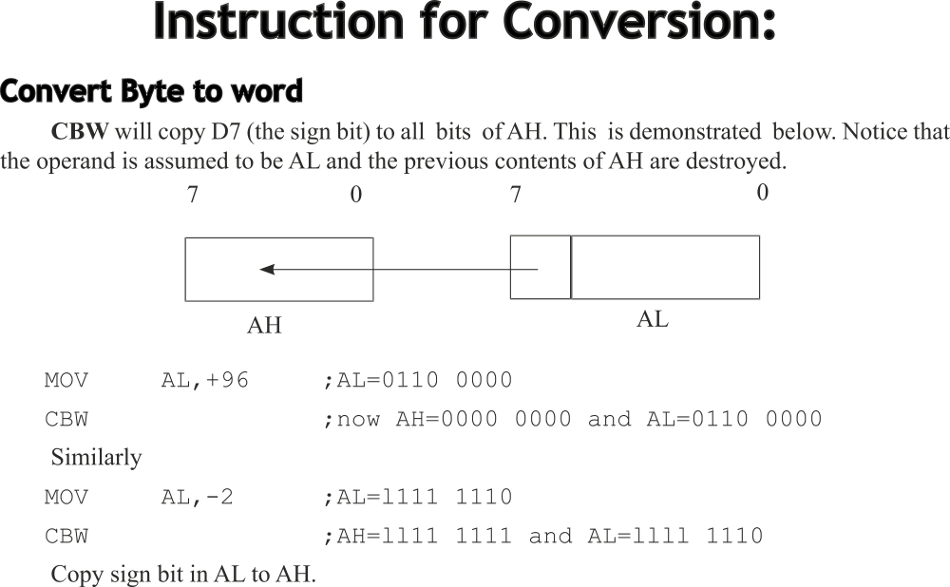

Slide 87
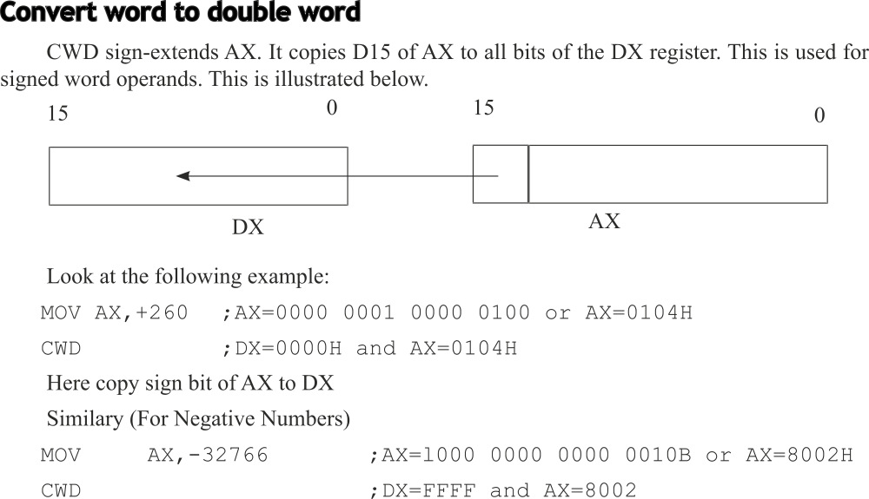

Slide 88
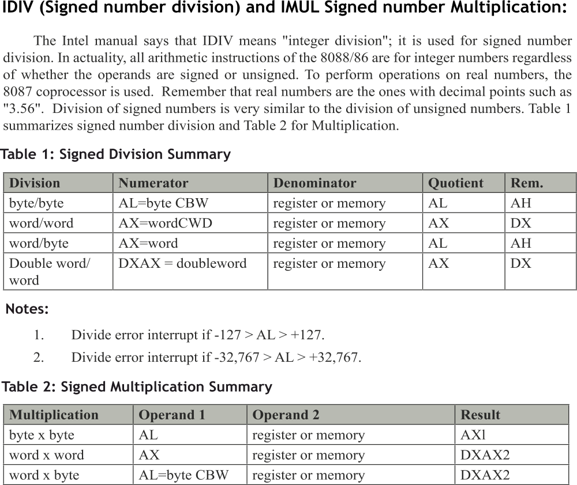

Slide 90
Memory interface
The most common types of memory are: ROM, Flash ROM, SRAM and DRAM
Memory pin connection:
Address Connections: The number of pins required for addressing is obtained by expressing the memory capacity as power of 2. The power value is the number of lines required.
eg. Memory capacity = 16KBytes
Expressing as a power of 2 we get 16KBytes = 2¹⁴ .Therefore 14 lines are required for addressing, typically marked as A₀ – A₁₃
(Range of address is 00000h to 03FFFFh)
Data connections: These are the pins through the data is read or written into the memory. It is labelled as D0 to D7.
Memory are expressed as M X N where M represents the no. of locations and N represents the bits per location.

Slide 91
Memory interface
Memory connections contd…….
Selection connections: Each memory device will have a enable signal called chip select / chip enable / select. It has to be selected to enable the memory IC. Generally the address lines are used for selection.
Control connections: For ROM there will be only one control signal called Output enable(OE) where as the RAM will need 2 control signals, one to read and other to write. These signals are controlled by the processor through the memory interface.
ROM memory:
It is a read only memory and permanently stores programs and data that are resident to the system. It is a non-volatile memory The types of ROM memory available are : PROM, EPROM, EEPROM, Flast ROM etc.

Slide 92
Memory interface
The EPROM IC has a number a 27XXX where XXX represents the number of Kilo bits storable in the IC
E.g, If the IC is 2732 It indicates that 32Kbits or 4KBytes of data can be stored.
If the IC is 271024 the capacity is 1024kbits or 128KBytes.
Similarly Static RAM has starting with 6XXX and DRAM with 4xxx
In case of dynamic RAM a signal for refreshing the memory value is required apart from the regular pins for address, data, selection and control.
ADDRESS DECODING: To interface memory to microprocessor, it is necessary to decode the address sent from the microprocessor. It makes the memory function at a unique section of memory. Without decoding only one memory device can be connected to the processor.

Slide 93
Memory interface
Simple NAND gate Decoder:
A NAND gate can be used as a decoder to enable the Chip selection of a memory IC. Generally CE is a low output. Hence NAND is preferred. NAND provides a low output when all its input are high.
Method of decoding using NAND:
1. Identify the lines of address required based on the memory size.
2. From A0 separate that many lines as identified in step 1.
3. The remaining address lines through NAND gate is used for Chip selection.
Eg. Interface a 2K * 8 EPROM for a address range of FF800 to FFFFF
For 2K locations 11 address lines are required. i.e A0 to A10.
The remaining bits A11 to A19 is used for chip select.

Slide 94
Memory interface
Expanding the address
A₁₉ A₁₈ A₁₇ A₁₆ A₁₅ A₁₄ A₁₃ A₁₂ A₁₁ A₁₀ A₉ A₈ A₇ A₆ A₅ A₄ A₃ A₂ A₁ A₀
FF800 1 1 1 1 1 1 1 1 1 0 0 0 0 0 0 0 0 0 0 0
FFFFF 1 1 1 1 1 1 1 1 1 1 1 1 1 1 1 1 1 1 1 1
The blue bits are used for chip enable and the red are used for addressing 2K locations
A11

Slide 95
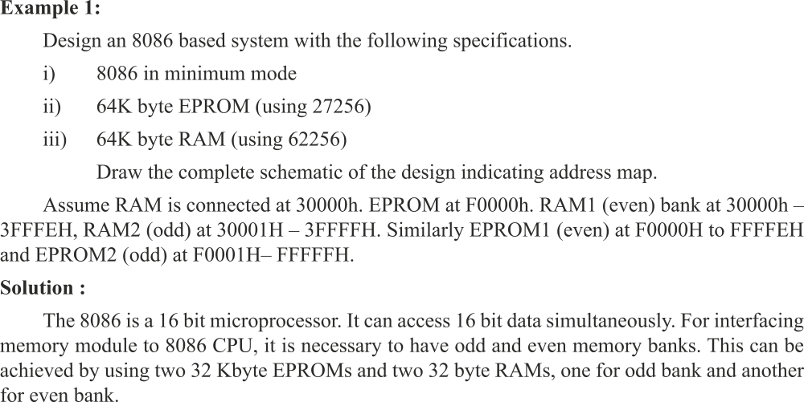

Slide 96
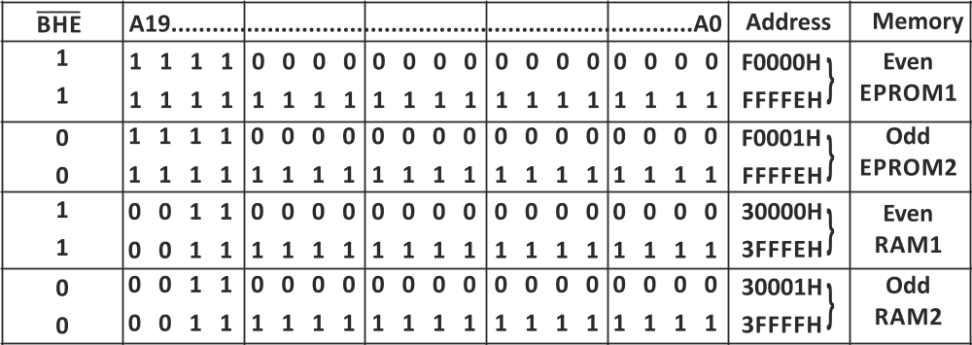
Memory Map

Slide 97
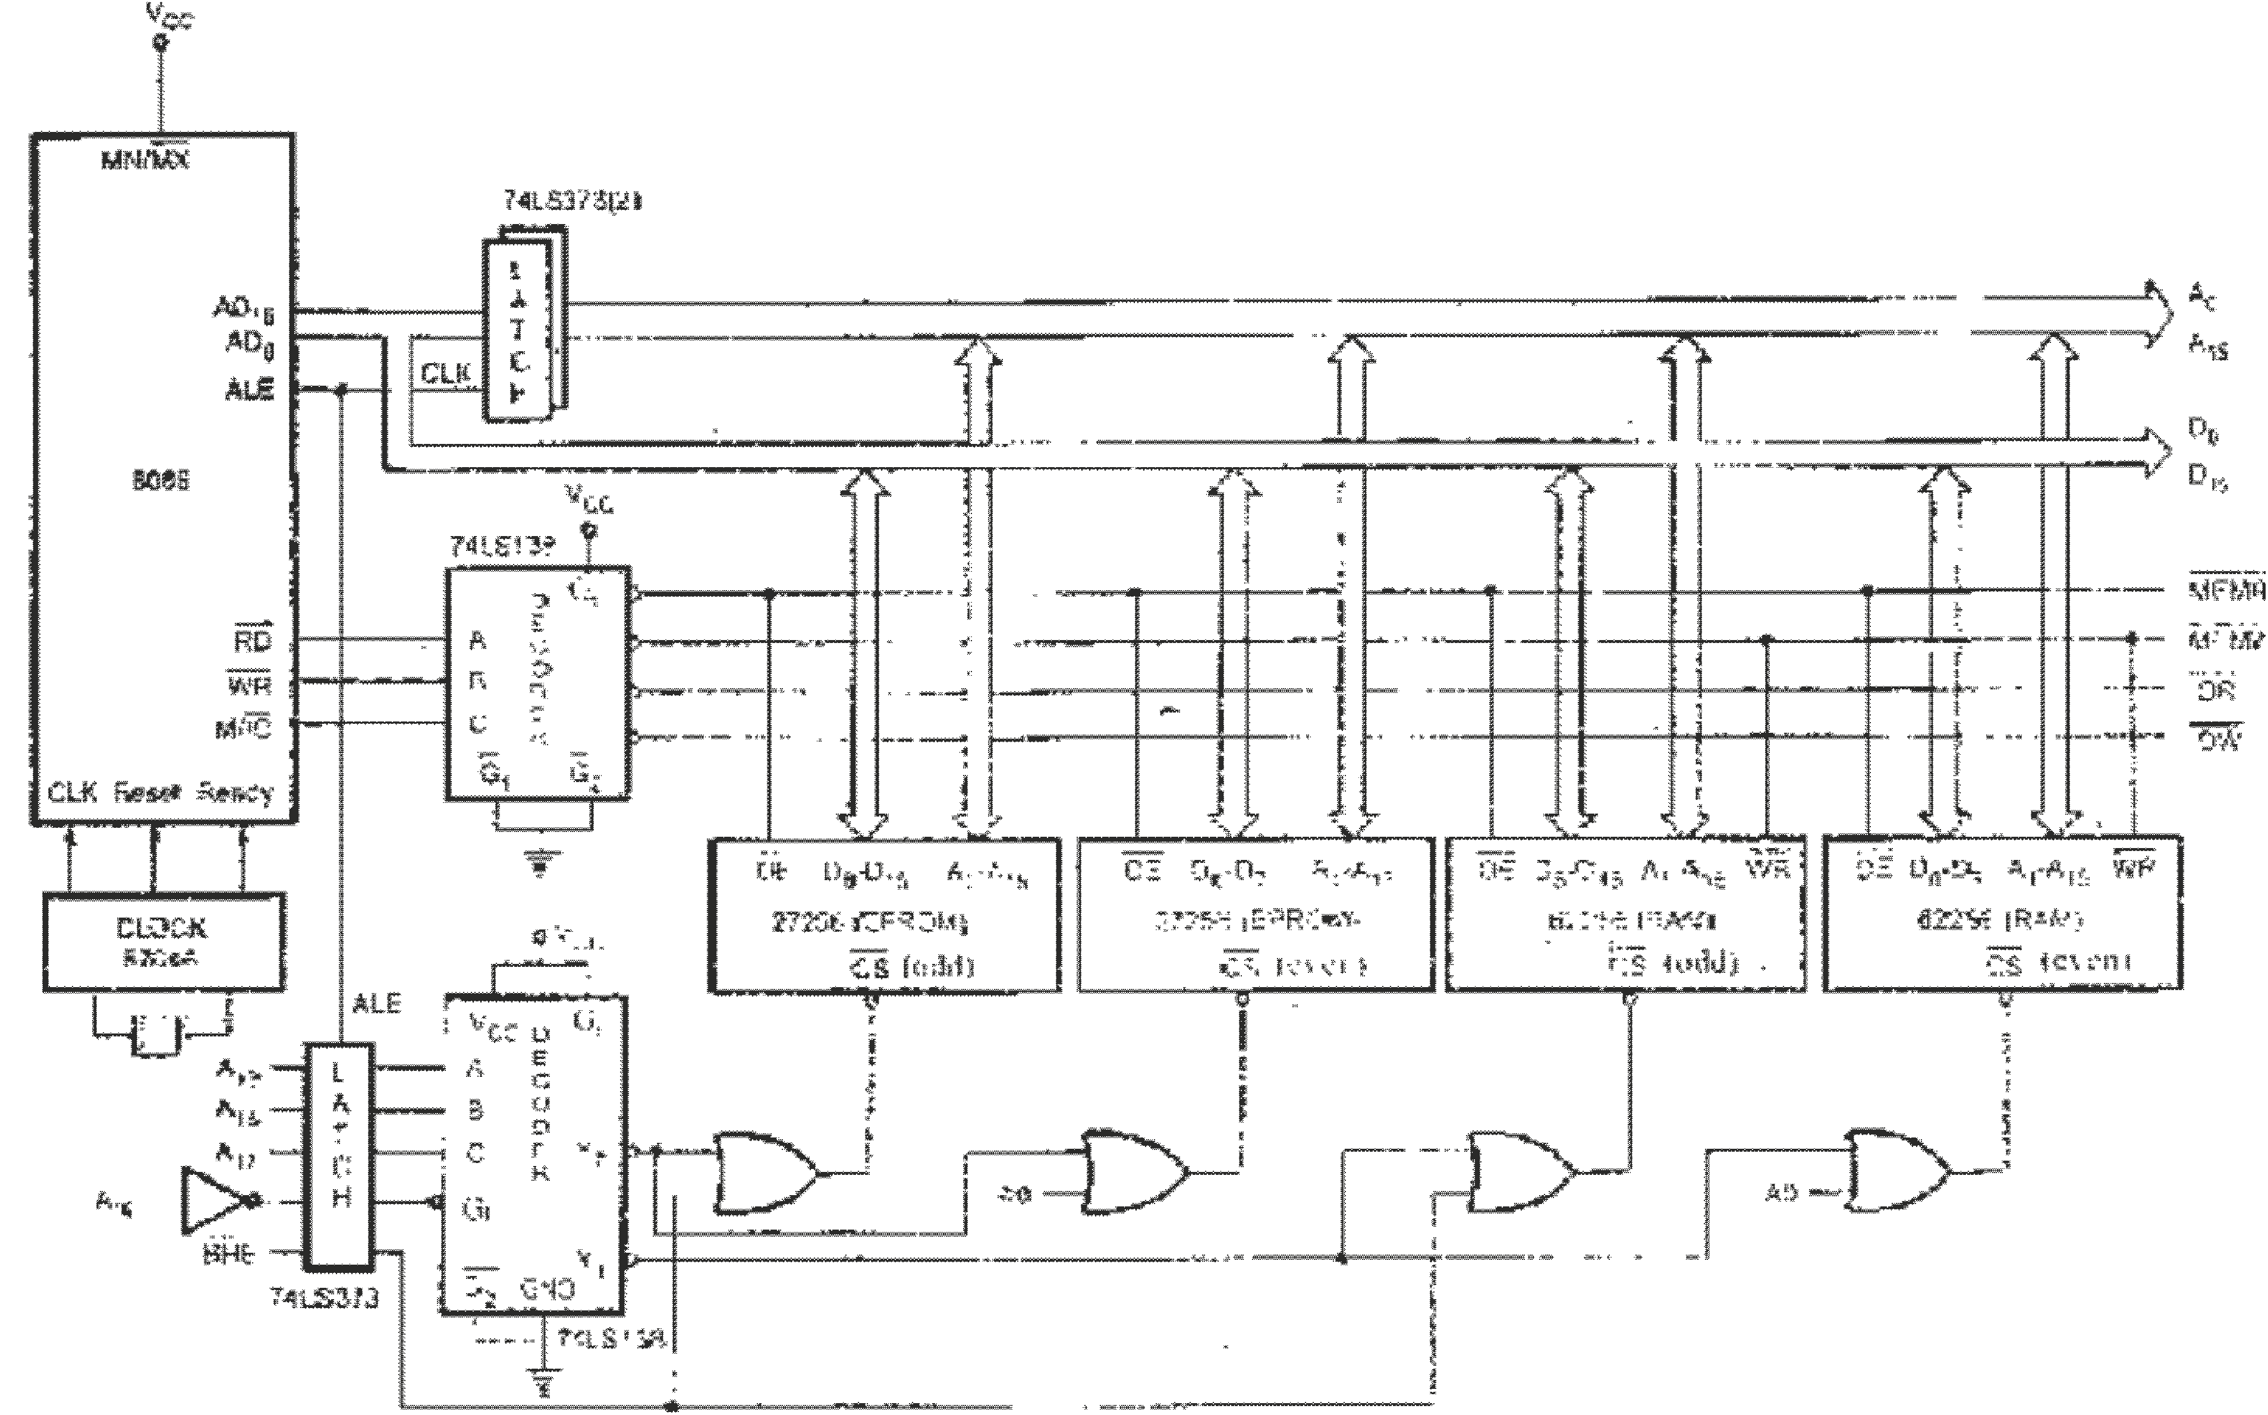
Diagram interfacing 64K RAM & 64K ROM

Slide 98
Thank you
Any Question…….. ?

